Slide 1


Predicting Alzheimer’s Disease Progression Using Multi-modal Deep Learning Approach

Slide 2

Presented By
JANNATUS SAKIRA KHONDAKER
ID - 20301468
TEAM NO - 26
RA - SANIA AZHMEE BHUIYAN
ST - FARAH BINTA HAQUE

Slide 3
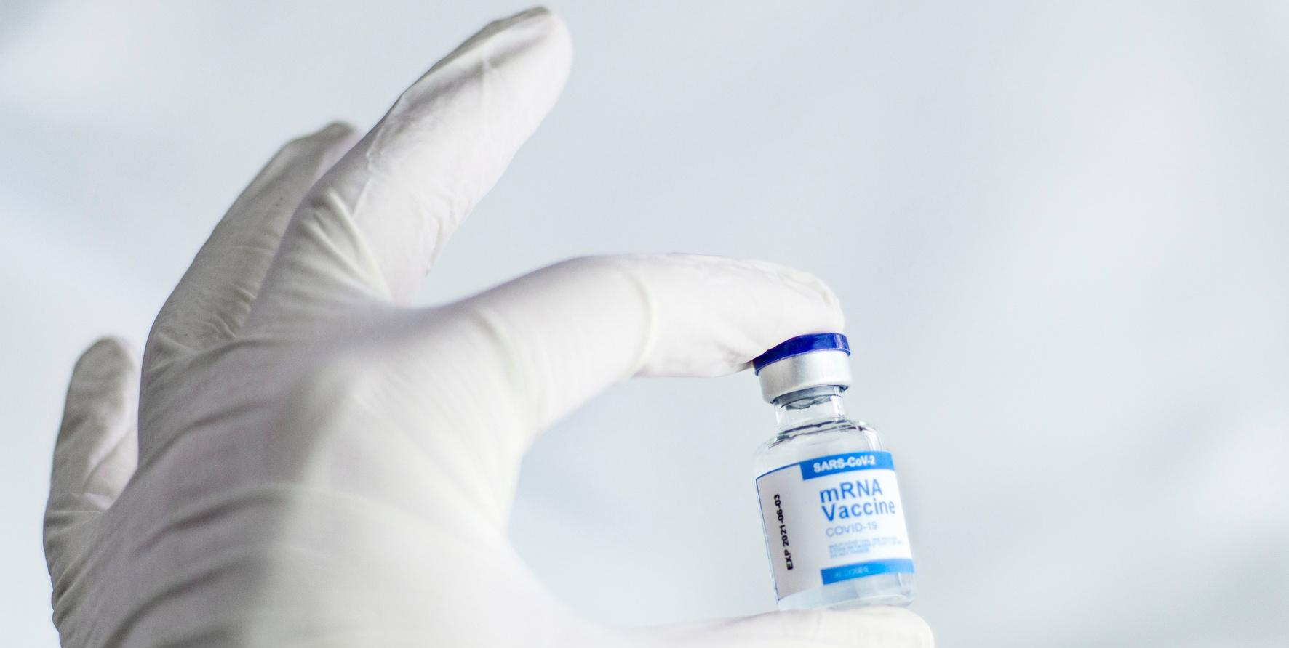
About this
Presentation
Alzheimer’s disease (AD) is a progressive neurodegenerative disorder that affects millions of people worldwide. Early detection and intervention are crucial for delaying the onset and severity of AD symptoms.

Slide 4
01.
Summary
Table of
Contents
02.
Limitation
03.
Synthesis

Slide 5

Summary

Slide 6


Hypothesis
The paper is about predicting Alzheimer’s disease (AD) progression using a multi-modal deep learning approach. As a result, the concept of mild cognitive impairment (MCI) was introduced. MCI, a prodromal form of AD, is defined to describe people who have mild symptoms of brain malfunction but can still perform everyday tasks.

Slide 7
Contribution
The paper proposes a multi-modal recurrent neural network (RNN) that can integrate longitudinal cognitive performance and cerebrospinal fluid (CSF) biomarkers, as well as cross-sectional neuroimaging and demographic data at baseline.

Slide 8

Methodology
Uses four types of data: demographic information, neuroimaging phenotypes measured by MRI, cognitive performance, and CSF measurements.
The paper trains a single GRU for each modality separately, and then concatenates the four feature vectors produced by each GRU to form an input for the final prediction.
The paper uses l1-regularized logistic regression for the classification between MCI converters and non-converters.
The paper tests and compares the performance with other methods using cross-sectional or single-modal data.

Slide 9
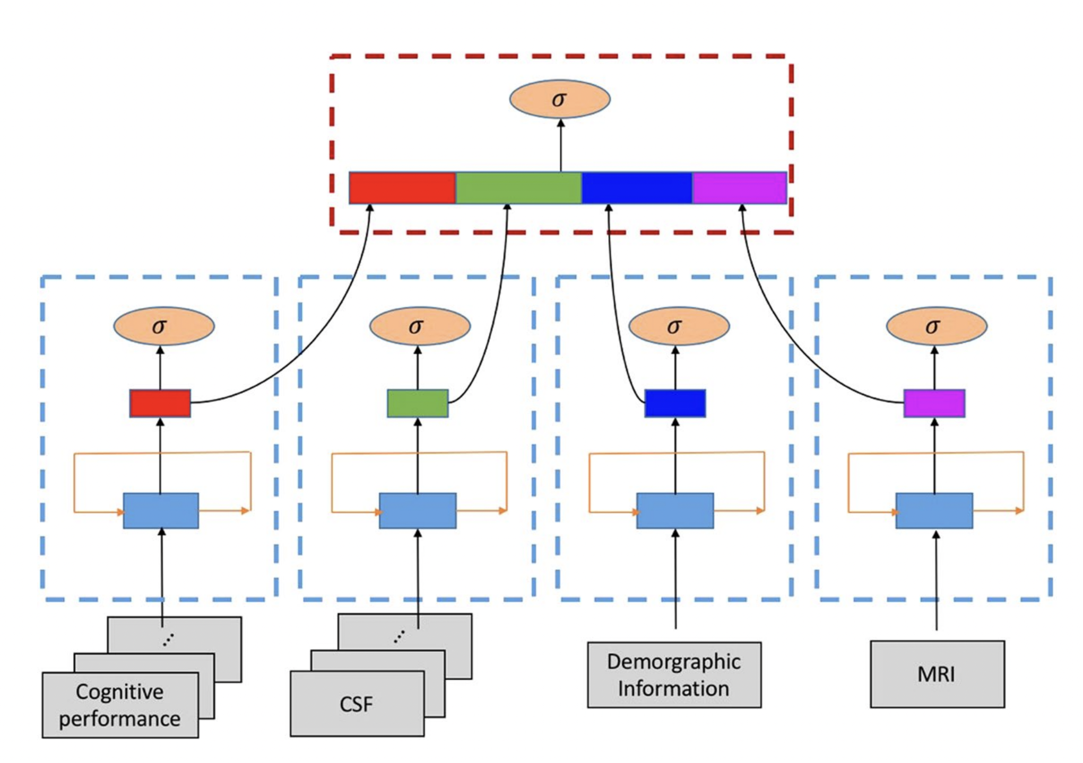
Process of Methodology

Slide 10


CONTRIBUTION
The paper shows that the proposed method achieves the best performance with 81% accuracy.
84% sensitivity when incorporating longitudinal multi-modal data.

Slide 11


LIMITATIONS
First Limitation
Second Limitation
Data scarcity and imbalance
Feature extraction and integration

Slide 12



Synthesis
Potential applications
The authors’ model could be applied to other neurodegenerative diseases that have similar
biomarkers and progression patterns as AD.
Future Scopes
The authors’ model could also be validated on larger and more diverse datasets, such as those from different countries or ethnicities, to test its scalability and transferability.

Slide 13
Thank you!

